Slide 1


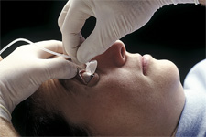
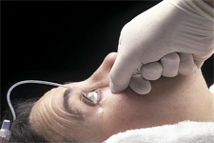
education tip
Morgan Lens: Eye irrigation
Obtain order to insert anesthetic. Have patient look down, insert Morgan Lens under upper lid. Have patient look up, retract lower lid, drop lens in place.
Adjust flow rate. Do not run IV dry.
attaches to IV tubing;
start flow prior to
insertion. (Normal
saline)
lens
REMOVAL: CONTINUE FLOW, have patient look up, retract lower lid - hold position. Slide lens out & discontinue flow.
February 18, 2014

